Slide 1
Cultural Time Capsule
Extreme sports

Slide 2
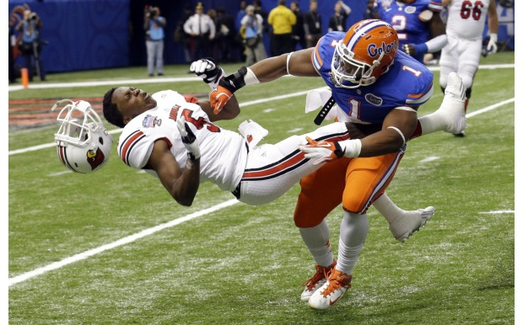
Football

Slide 3
Football
Football is a contact sport. There is a lot of hard hitting and a lot of people get concussions. We are starting to make things better to prevent the concussions. Like concussion preventing helmets. They are also getting stricter on helmet to helmet hitting.

Slide 4
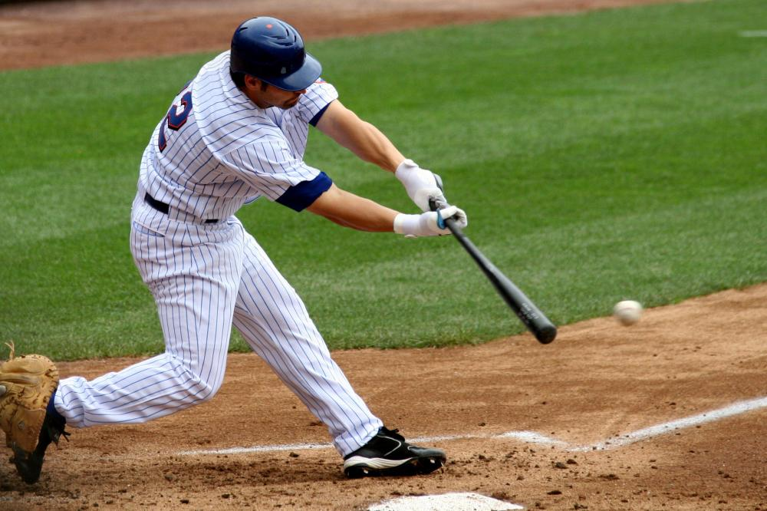
Baseball

Slide 5
Baseball
Baseball has been big since 1845. It has played a big and part in America’s history. They are trying to make more regulations on bats so you can’t hit the ball as hard or as far. But they are also developing different pitches and ways to throw them to prevent the batters to hit it as far or to hit it at all.

Slide 6
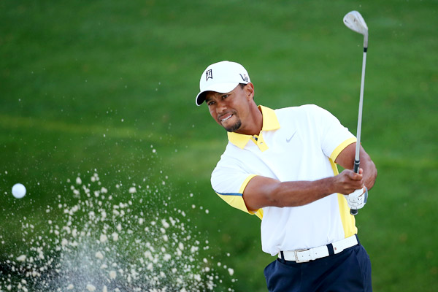
Golf

Slide 7
Golf
Golf is one of the highest paid sports. They are finding ways to make clubs hit further and harder, easier. They are finding ways to swing the club to make it go further, also.

Slide 8
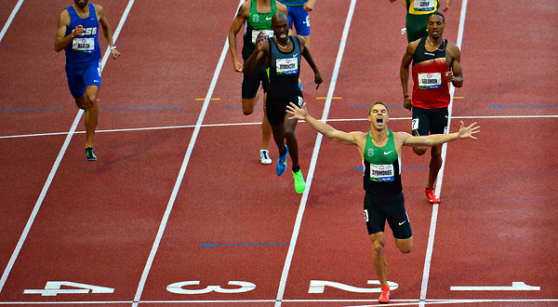
Track

Slide 9
Track & Field
Track is a running and throwing sport. They are making cleats lighter and more aerodynamic to make the runners faster. They are also developing your running form, to make you run faster.

Slide 10
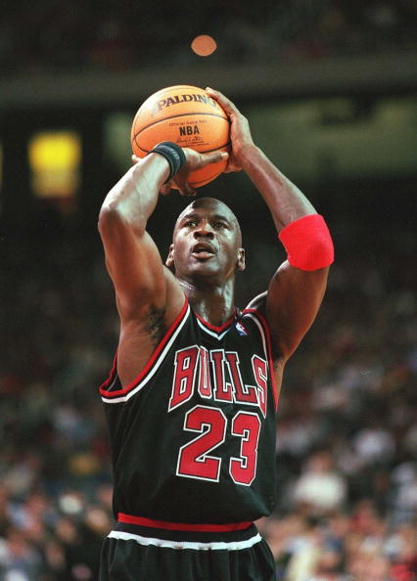
Basketball

Slide 11
Basketball
Basketball is a very popular sport in the U.S. They are making shoes specialized just for playing basketball, that will give your ankles more support, but are also making them lighter to be able to jump higher and run faster.

Slide 12
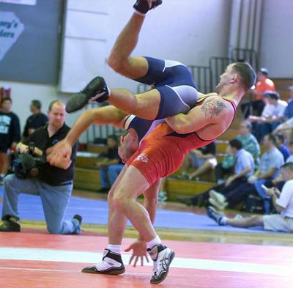
Wrestling

Slide 13
Wrestling
There are a lot of people that enjoy watching wrestling. They are making more and more ways to “tap out” or to “pin” the opponent. They are also making more ways to prevent yourself from being “pinned”.

Slide 14
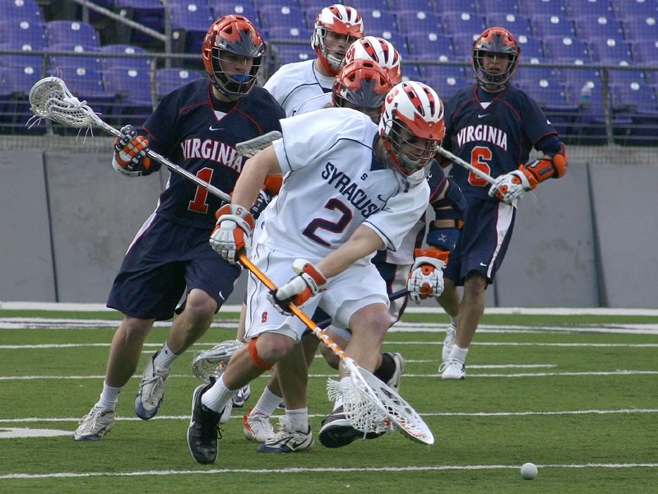
Lacrosse

Slide 15
Lacrosse
Lacrosse is played in many different levels. They are played at the professional level, the college level, the high school level, and little league. They are developing better sticks to make it easier to score.

Slide 16
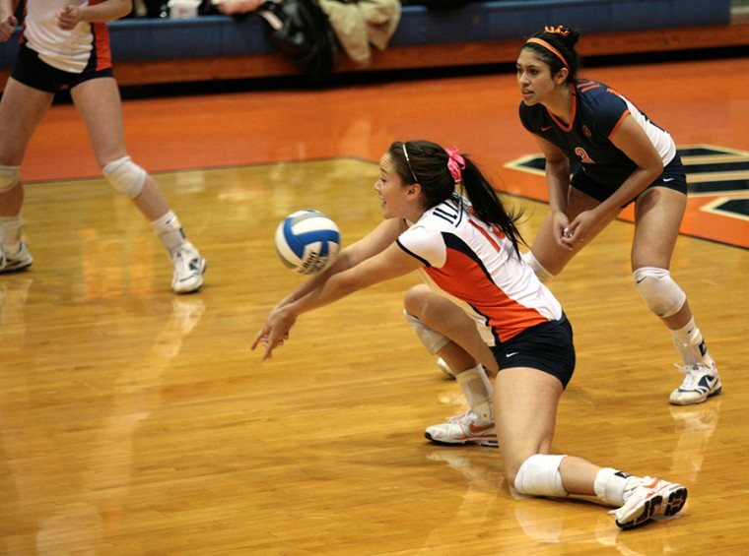
Volleyball

Slide 17
Volleyball
Volleyball has become very popular in the past few years. It is played in a gym, but also on sand. They are developing shoes to give you more traction when you are playing in a gym.

Slide 18
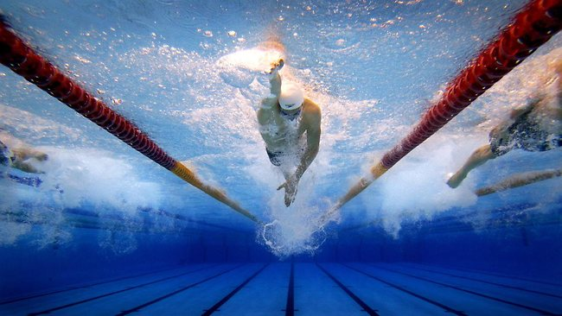
Swimming

Slide 19
Swimming
Swimming has become more popular that it used to be. They are developing different ways to swim so that you can swim faster. They are also developing different types of goggles so that it is easier to see when you are under the water.

Slide 20
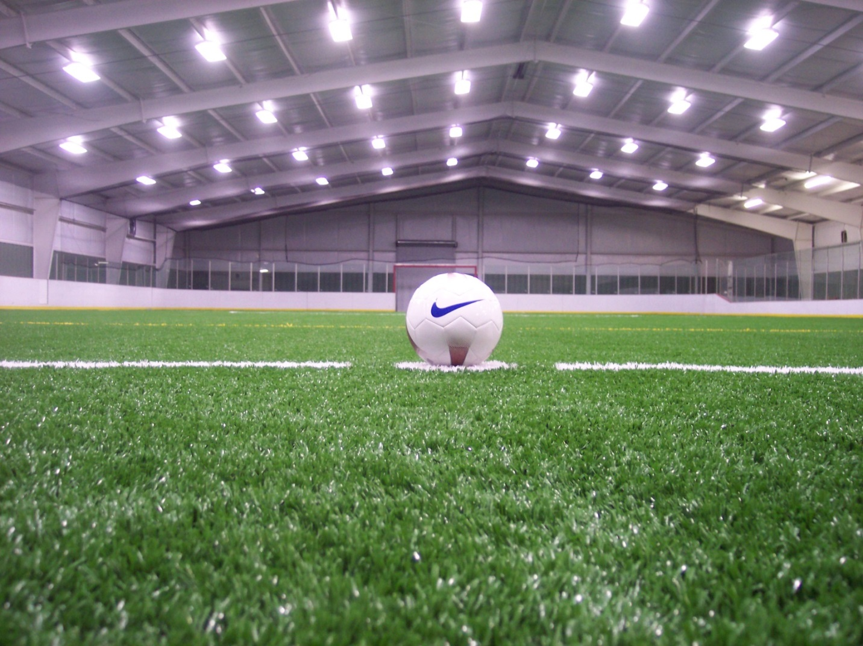
Soccer

Slide 21
Soccer
Soccer is a sport where you kick a ball and try to get it in the net, while trying to keep the ball away from the other team. The sport is slowly becoming less popular. There is occasional contact in this sport.

Slide 22
Summary
All of these sports have developed greatly in the past years. Some have become more popular, and some have become less popular.

Slide 23
Sources
http://espn.go.com/blog/nflnation
http://www.olympic.org/
http://www.laxmagazine.com/genrel/062613_lacrosse_moves_step_closer_to_olympics
http://sportsillustrated.cnn.com/

