Slide 1
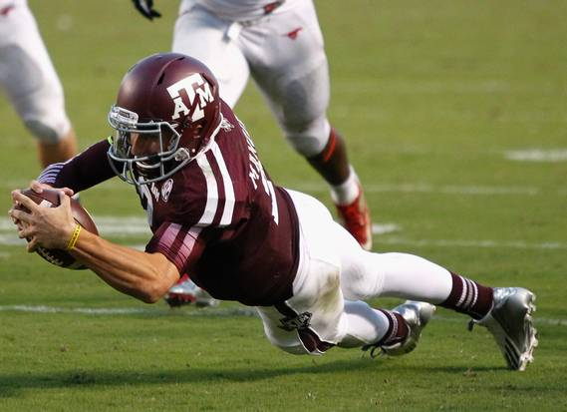
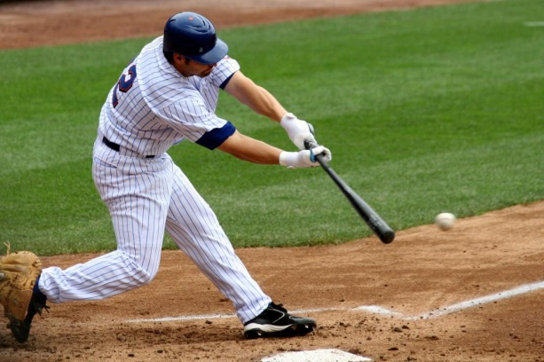
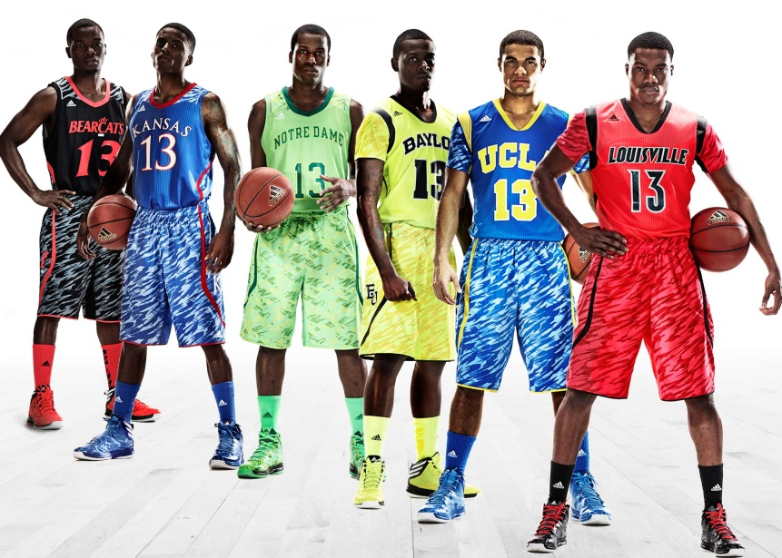
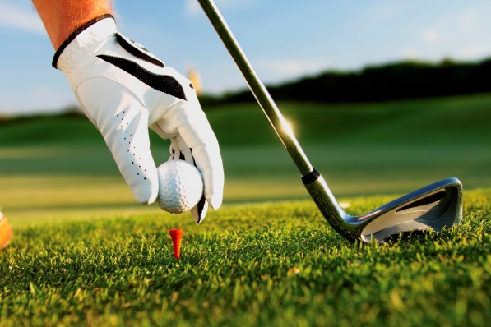
Extreme Sports
By: Josh Liberati, Jannik Schmidt, Cody Freeland

Slide 2
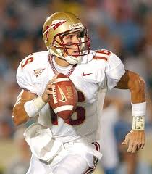
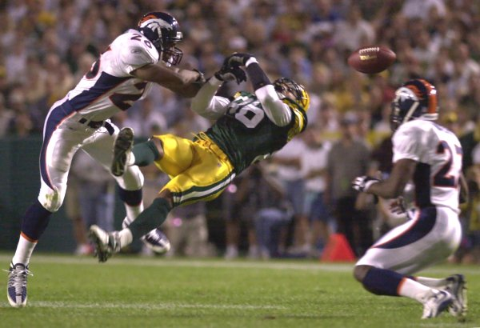
Football
Football is a sport played by eleven people on offence and eleven on defense.
Football is a very competitive, and physical sport to play.
The most important position on the field is the Quarter Back. The quarter back is the Eyes and the Mind of the field.

Slide 3
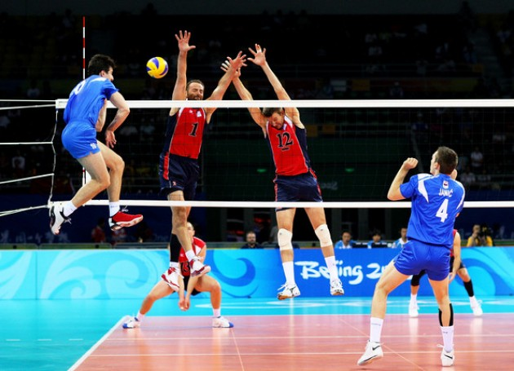
Volleyball
-Is a sport mostly played by women
-Its played 6 vs.6 with a net in the middle of the court.
-The object of the game is to get the ball to hit the floor on the opponents side of the net by only touching the ball three times.
-Play to 25 points
-Played best of 3 or 5.

Slide 4
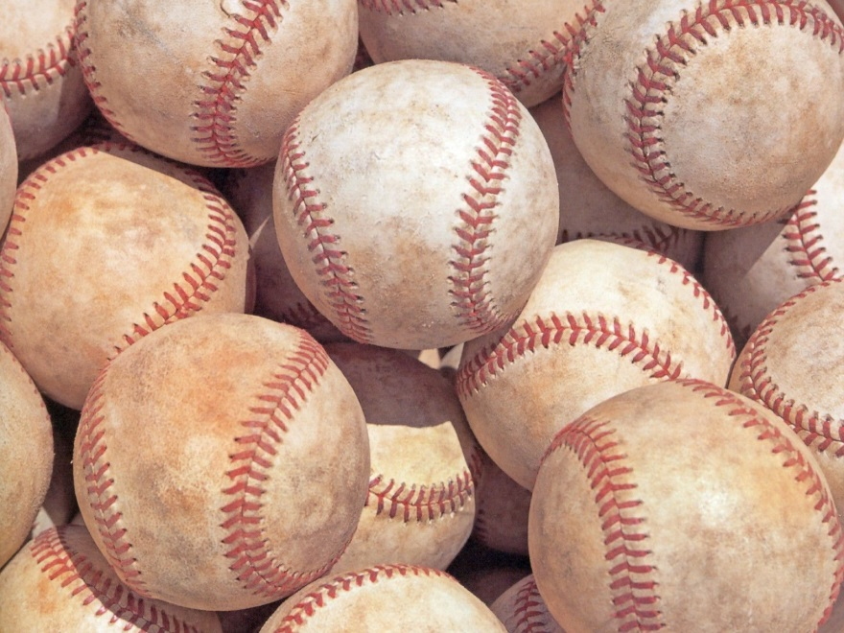
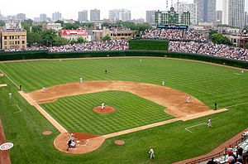
Baseball
-Sport played by 9 on defense and one batter, batting at a time.
-The pitcher is the most important position on the field. The pitcher’s job is to throw the ball and try to strike the batter out.
-Each batter gets 3 strikes or your out. If the pitcher throws 4 balls the batter gets his base.
-There’s three bases to run around and then you go to home plate and score a point.

Slide 5
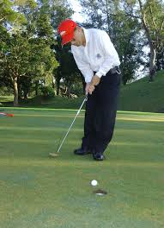
Golf
-Golf is a very difficult sport. This sport is a individual sport. You cannot play this game with a bad attitude.
-Golf you want to get the lowest score you can.
-There are 3 types of golf holes, a par 3, a par 4, and a par 5.
- A par 3 is the shortest, the par 4 is in the middle, and a par 5 is the longest.

Slide 6
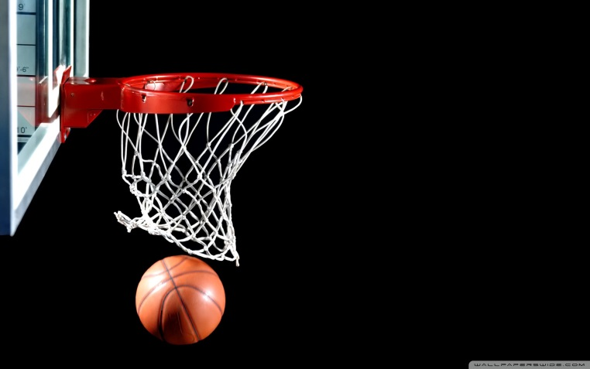
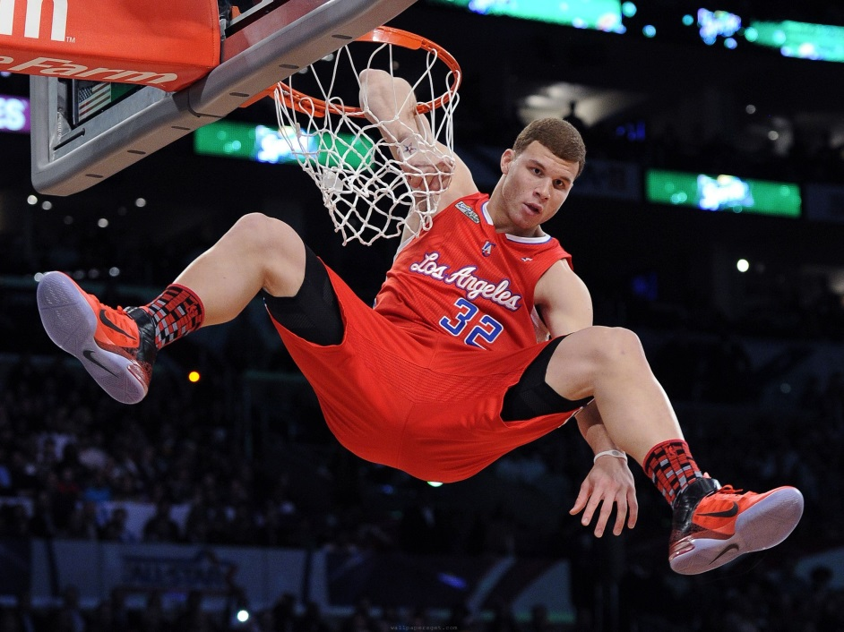
Basketball
-Basketball is a sport played with 5 people on each team.
-The goal of the game is to shoot the ball into the hoop.
-If you are outside the 3pt ring a basket is worth 3 points
-If not it is worth 2 points.

Slide 7
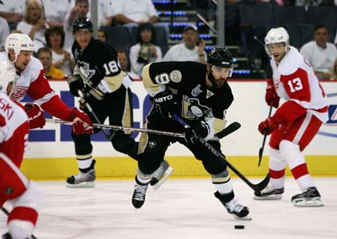
Hockey
-Hockey is a very physical sport.
-Hockey is played on ice and you use ice skates.
-The object is to get the puck into the goal and score.
-In Hockey you can get into fights and only get a penatly.

Slide 8
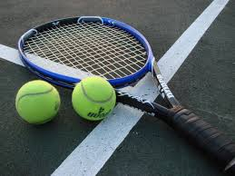
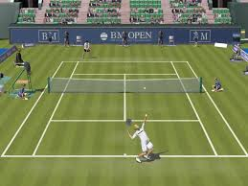
Tennis
-Tennis is played with 1 person on each team
-The object of tennis is to hit the tennis ball, within the opponents area in bounds to get a point.
-Tennis is not very popular around Lisbon.
-In other parts of the U.S. it is very popular however.

Slide 9
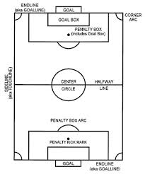
Soccer
Sport played between two teams of eleven with a round ball.
Played by over 250 million players in over 200 countries.
Most countries call it football.
Been in the Olympics since 1900
11 players on each side.

Slide 10
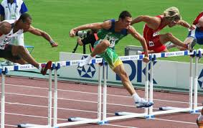
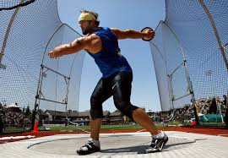
Track and Field
-Track and field is a spring sport played during baseball season.
-There are many different events you can run in track including the 100 meter dash, 300 meter hurdles and the longer distance 1600 meter runs.
-There are four main field events, including Shotput, Discus, High jump and Long jump

Slide 11
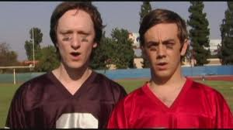
Summary
-Sports today are a big deal in the United States as well as around the world.
-Some of the most watched Television programs are football games and soccer games depending on where you live.
-Sports play a huge roll in life today.

