Slide 1
Technology
By: Taylor Ballard
Tylor Thompson

Slide 2
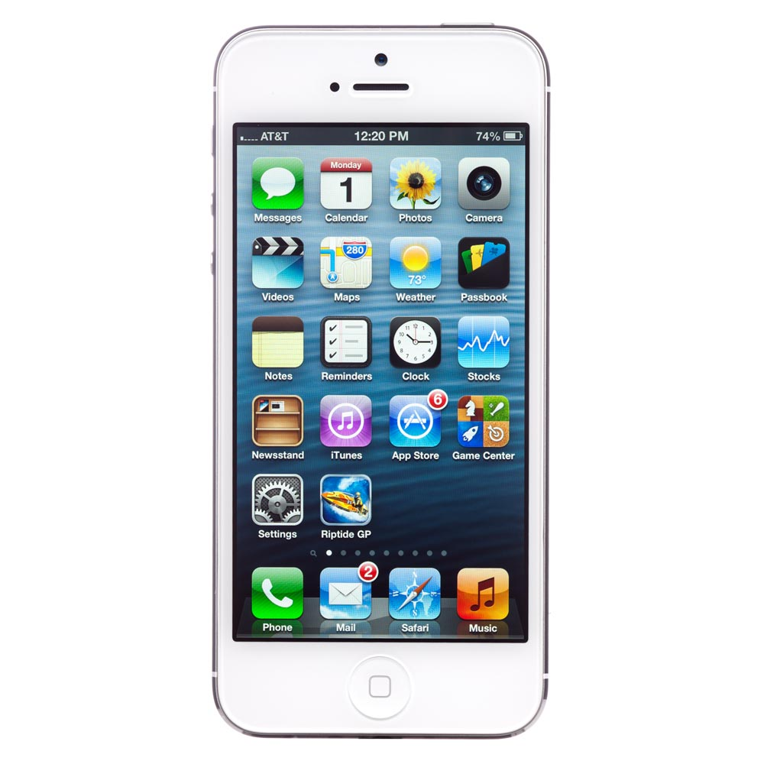
iPhone

Slide 3
IPhone: it is a touch screen phone

Slide 4
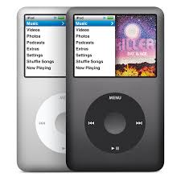

Slide 5
Ipod you can use it for the internet music and take pictures on it some are touch screen to.

Slide 6
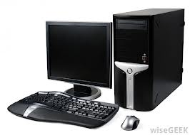

Slide 7
Computer: this is used for the internet save pictures to use it for work you can do a lot of stuff on it.

Slide 8
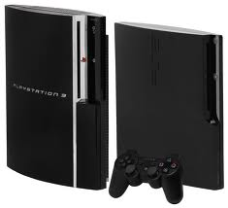
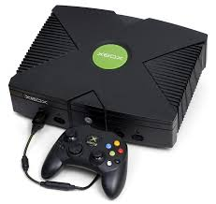
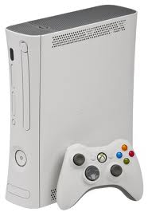
Game systems

Slide 9
Game systems: you can play games watch movies play online with other people across the [earth].

Slide 10
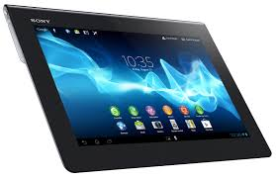
Tablet

Slide 11
Tablet its just a touch screen computer.

Slide 12
We got our pictures from google

