Slide 1
The Age of Technology
By: Dustin A. McCartney Jr
Tyler Howe
Jacob Davis

Slide 2
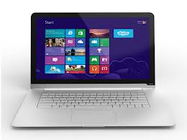
The Basis of Everyday Things

Slide 3
The Basics of our world
From the time we wake up in the morning to the time we go to bed we use technology.
We have advanced years from the time that the first operating system was invented (MS DOS)
We tend to use technology for the most minute tasks and we have become so dependent on its ability to make our lives easier that any malfunction can put us in a panic.

Slide 4
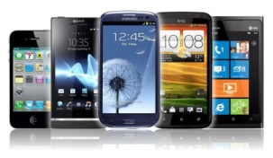
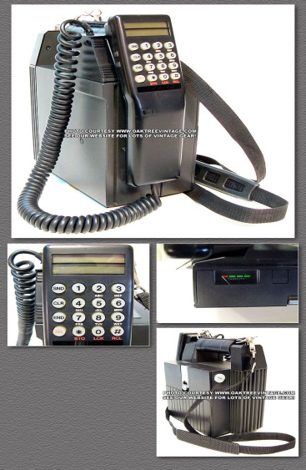
Getting Smaller but Bigger

Slide 5
Getting Smaller but Bigger
A lot of our technology has advanced by increasing specs but decreasing in size.
We have been able to speed up our systems exponentially since the first computer which was the size of a closet

Slide 6
Expansion of the internet

Slide 7
Expansion of the Internet
The internet has expanded immensely since the 1900’s
We now have access to a large number of browsers and limitless ammounts of information at your finger tips

Slide 8
EGames

Slide 9
EGames
Not only has technology grew for efficiency but also for entertainment and competition
Egames and Esports have grew as a very popular competition style while also having fun.

Slide 10
WIFI

Slide 11
Wi-Fi is a very important thing in our society it is what allows us to access information from anywhere at the touch of our fingers.

Slide 12
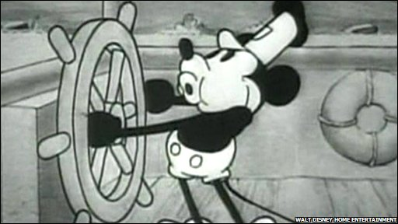
Animations
We have evolved our ability to create animated pictures from the first Disney and warner bros. cartoons to the Japanese anime that is watched today

Slide 13
Bibliography
History project photo sources:
Laptop/gledster2000.blogspot.com
Binary code/baileypublishing.webs.com
Blogs.which.co.uk
Oaktreevintage.com
Hpr1.com
Logonoid.com
Knowhow.com

