Slide 1
The Past to the future
By Darren McDole, Austin Barnes, Charles Bates george dilling

Slide 2
Past of 2013
We are able to get electronics such as- cell phones, laptops, IPod's,
Wi-Fi your able to get on without plugging in your internet cord.
some cars have electronics in them such as g.p.s.

Slide 3
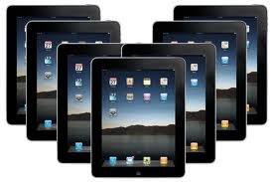
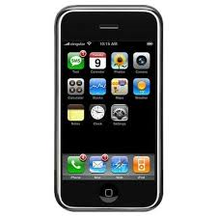
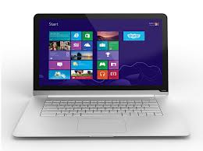
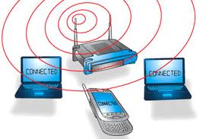

Slide 4
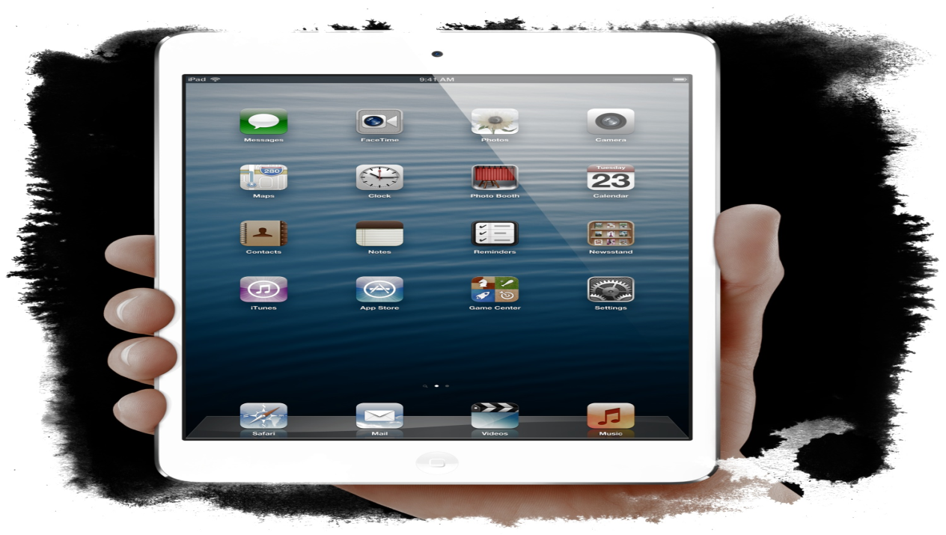
I pads are a portable computers. In the future there maybe would be improve Wi-Fi. There is some things that can be portable like laptops, IPod's, IPod touches..

Slide 5
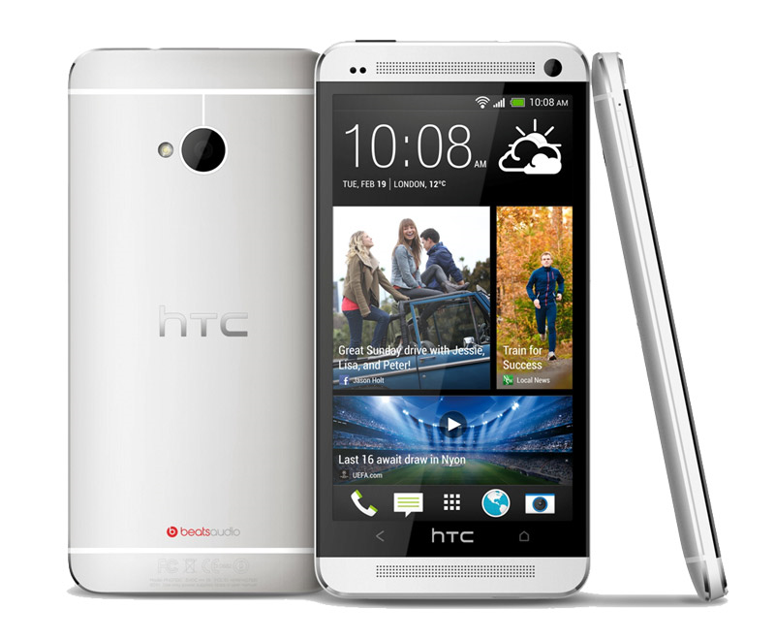
Phones are use to text/call people. In the future your phones may have improve Wi-Fi but it doesn’t really look that way…..

Slide 6
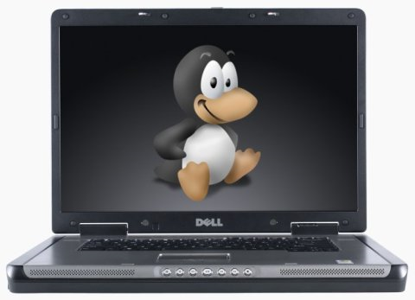

Slide 7
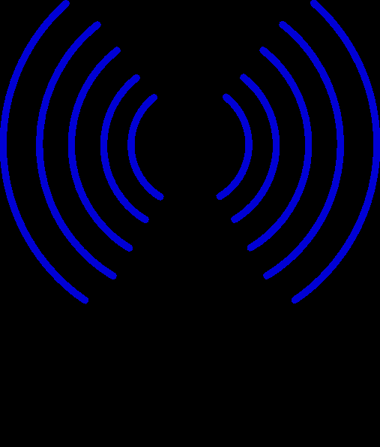
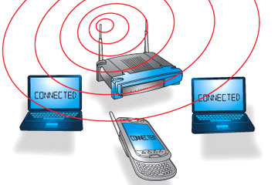
Wi-Fi may be improve meaning every house may have Wi-Fi in there homes…. But right now there isn’t to may people that doesn’t have Wi-Fi…

Slide 8
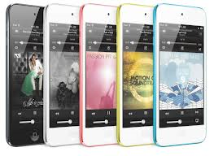
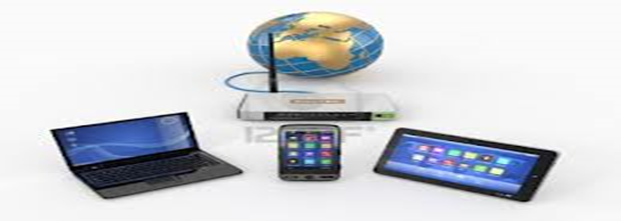
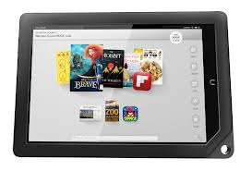

Slide 10
Summery
Technology we have now its popular and in the future technology is improving
Source is google / images

